Slide 1
Course Name: Database Systems Course Code: CS52 Credits: 3:1:0 UNIT 5 Term: Oct 2021 – Feb 2022
M.S. Ramaiah Institute of Technology
(Autonomous Institute, Affiliated to VTU)
Department of Computer Science and Engineering
Faculty:
Dr. Sini Anna Alex

Slide 2
Chapter 17
Introduction to Transaction Processing Concepts and Theory

Slide 3
Introduction to Transaction Processing
Single-User System:
At most one user at a time can use the system.
Multiuser System:
Many users can access the system concurrently.
Concurrency
Interleaved processing:
Concurrent execution of processes is interleaved in a single CPU.
Parallel processing:
Processes are concurrently executed in multiple CPUs.

Slide 4
Introduction to Transaction Processing
A Transaction:
Logical unit of database processing that includes one or more access operations (read -retrieval, write - insert or update, delete).
A transaction (set of operations) may be stand-alone specified in a high level language like SQL submitted interactively, or may be embedded within a program.
Transaction boundaries:
Begin and End transaction.
An application program may contain several transactions separated by the Begin and End transaction boundaries.

Slide 5
Introduction to Transaction Processing
SIMPLE MODEL OF A DATABASE (for purposes of discussing transactions):
A database is a collection of named data items
Granularity of data - a field, a record , or a whole disk block (Concepts are independent of granularity)
Basic operations are read and write
read_item(X): Reads a database item named X into a program variable. To simplify our notation, we assume that the program variable is also named X.
write_item(X): Writes the value of program variable X into the database item named X.

Slide 6
Introduction to Transaction Processing
READ AND WRITE OPERATIONS:
Basic unit of data transfer from the disk to the computer main memory is one block. In general, a data item (what is read or written) will be the field of some record in the database, although it may be a larger unit such as a record or even a whole block.
read_item(X) command includes the following steps:
Find the address of the disk block that contains item X.
Copy that disk block into a buffer in main memory (if that disk block is not already in some main memory buffer).
Copy item X from the buffer to the program variable named X.

Slide 7
Introduction to Transaction Processing
READ AND WRITE OPERATIONS (contd.):
write_item(X) command includes the following steps:
Find the address of the disk block that contains item X.
Copy that disk block into a buffer in main memory (if that disk block is not already in some main memory buffer).
Copy item X from the program variable named X into its correct location in the buffer.
Store the updated block from the buffer back to disk (either immediately or at some later point in time).

Slide 8
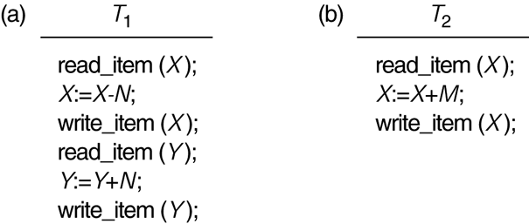
Two sample transactions
Two sample transactions:
(a) Transaction T1
(b) Transaction T2

Slide 9
Introduction to Transaction Processing
Why Concurrency Control is needed:
The Lost Update Problem
This occurs when two transactions that access the same database items have their operations interleaved in a way that makes the value of some database item incorrect.
The Temporary Update (or Dirty Read) Problem
This occurs when one transaction updates a database item and then the transaction fails for some reason.
The updated item is accessed by another transaction before it is changed back to its original value.
The Incorrect Summary Problem
If one transaction is calculating an aggregate summary function on a number of records while other transactions are updating some of these records, the aggregate function may calculate some values before they are updated and others after they are updated.

Slide 10
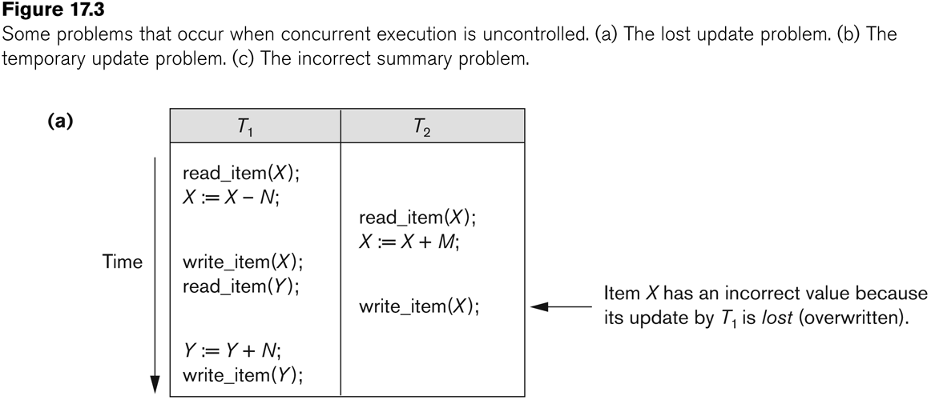
Concurrent execution is uncontrolled: (a) The lost update problem.

Slide 11
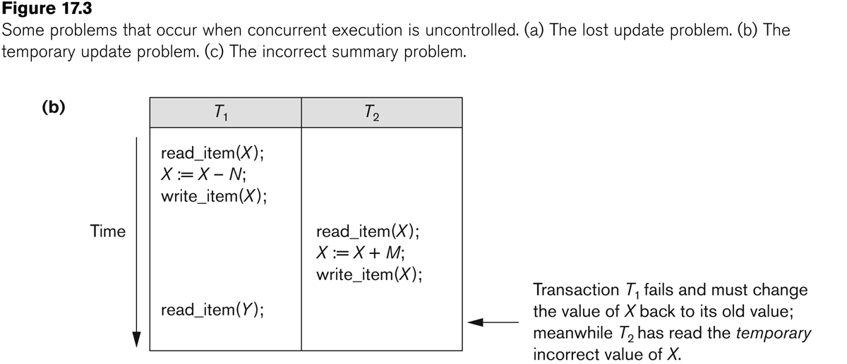
Concurrent execution is uncontrolled: (b) The temporary update problem.

Slide 12
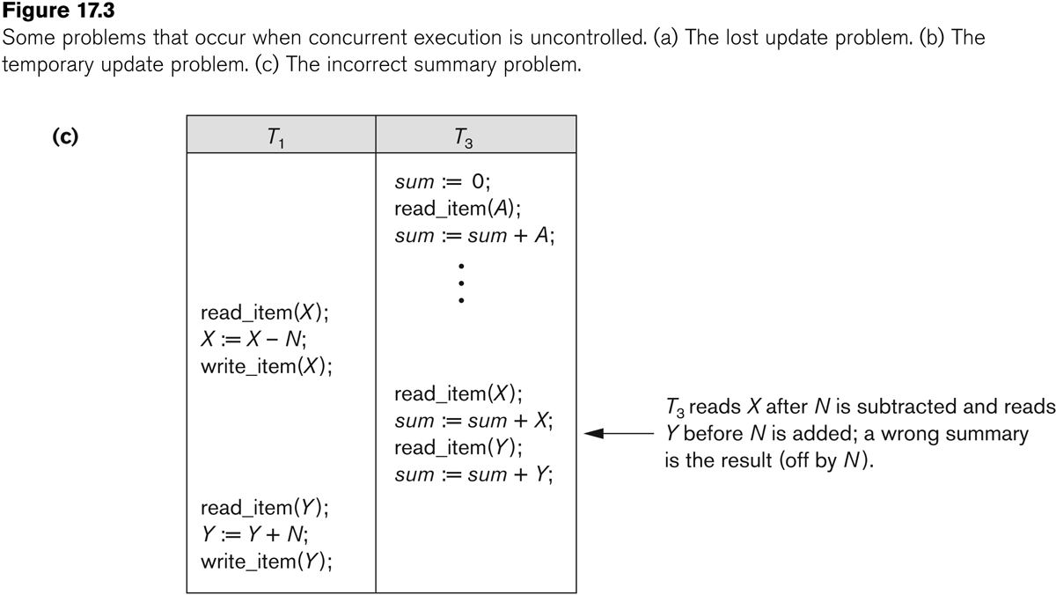
Concurrent execution is uncontrolled: (c) The incorrect summary problem.

Slide 13
Introduction to Transaction Processing
Why recovery is needed:
(What causes a Transaction to fail)
1. A computer failure (system crash):
A hardware or software error occurs in the computer system during transaction execution. If the hardware crashes, the contents of the computer’s internal memory may be lost.
2. A transaction or system error:
Some operation in the transaction may cause it to fail, such as integer overflow or division by zero. Transaction failure may also occur because of erroneous parameter values or because of a logical programming error. In addition, the user may interrupt the transaction during its execution.

Slide 14
Introduction to Transaction Processing
Why recovery is needed (Contd.):
(What causes a Transaction to fail)
3. Local errors or exception conditions detected by the transaction:
Certain conditions necessitate cancellation of the transaction. For example, data for the transaction may not be found. A condition, such as insufficient account balance in a banking database, may cause a transaction, such as a fund withdrawal from that account, to be canceled.
A programmed abort in the transaction causes it to fail.
4. Concurrency control enforcement:
The concurrency control method may decide to abort the transaction, to be restarted later, because it violates serializability or because several transactions are in a state of deadlock .

Slide 15
Introduction to Transaction Processing
Why recovery is needed (contd.):
(What causes a Transaction to fail)
5. Disk failure:
Some disk blocks may lose their data because of a read or write malfunction or because of a disk read/write head crash. This may happen during a read or a write operation of the transaction.
6. Physical problems and catastrophes:
This refers to an endless list of problems that includes power or air-conditioning failure, fire, theft, sabotage, overwriting disks or tapes by mistake, and mounting of a wrong tape by the operator.

Slide 16
Transaction and System Concepts
A transaction is an atomic unit of work that is either completed in its entirety or not done at all.
For recovery purposes, the system needs to keep track of when the transaction starts, terminates, and commits or aborts.
Transaction states:
Active state
Partially committed state
Committed state
Failed state
Terminated State

Slide 17
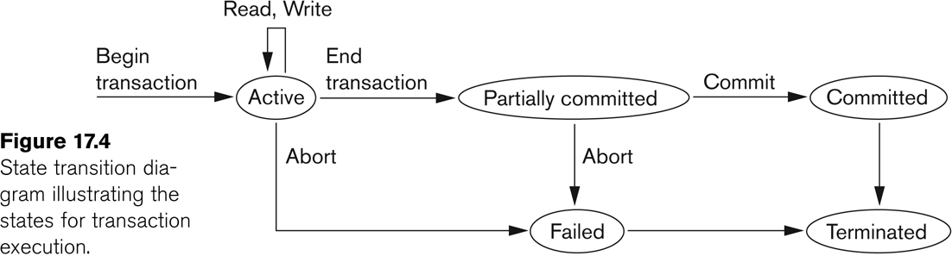
State transition diagram illustrating the states for transaction execution

Slide 18
Transaction and System Concepts
Recovery manager keeps track of the following operations:
begin_transaction: This marks the beginning of transaction execution.
read or write: These specify read or write operations on the database items that are executed as part of a transaction.
end_transaction: This specifies that read and write transaction operations have ended and marks the end limit of transaction execution.
At this point it may be necessary to check whether the changes introduced by the transaction can be permanently applied to the database or whether the transaction has to be aborted because it violates concurrency control or for some other reason.

Slide 19
Transaction and System Concepts
Recovery manager keeps track of the following operations (contd…):
commit_transaction: This signals a successful end of the transaction so that any changes (updates) executed by the transaction can be safely committed to the database and will not be undone.
rollback (or abort): This signals that the transaction has ended unsuccessfully, so that any changes or effects that the transaction may have applied to the database must be undone.
Recovery techniques use the following operators:
undo: Similar to rollback except that it applies to a single operation rather than to a whole transaction.
redo: This specifies that certain transaction operations must be redone to ensure that all the operations of a committed transaction have been applied successfully to the database.

Slide 20
Transaction and System Concepts
The System Log
Log or Journal: The log keeps track of all transaction operations that affect the values of database items.
This information may be needed to permit recovery from transaction failures.
The log is kept on disk, so it is not affected by any type of failure except for disk or catastrophic failure.
In addition, the log is periodically backed up to archival storage (tape) to guard against such catastrophic failures.

Slide 21
Transaction and System Concepts
The System Log (cont):
T in the following discussion refers to a unique transaction-id that is generated automatically by the system and is used to identify each transaction:
Types of log record:
[start_transaction,T]: Records that transaction T has started execution.
[write_item,T,X,old_value,new_value]: Records that transaction T has changed the value of database item X from old_value to new_value.
[read_item,T,X]: Records that transaction T has read the value of database item X.
[commit,T]: Records that transaction T has completed successfully, and affirms that its effect can be committed (recorded permanently) to the database.
[abort,T]: Records that transaction T has been aborted.

Slide 22
Transaction and System Concepts
Recovery using log records:
If the system crashes, we can recover to a consistent database state by examining the log and using one of the techniques described in Chapter 19.
Because the log contains a record of every write operation that changes the value of some database item, it is possible to undo the effect of these write operations of a transaction T by tracing backward through the log and resetting all items changed by a write operation of T to their old_values.
We can also redo the effect of the write operations of a transaction T by tracing forward through the log and setting all items changed by a write operation of T (that did not get done permanently) to their new_values.

Slide 23
Transaction and System Concepts
Commit Point of a Transaction:
Definition a Commit Point:
A transaction T reaches its commit point when all its operations that access the database have been executed successfully and the effect of all the transaction operations on the database has been recorded in the log.
Beyond the commit point, the transaction is said to be committed, and its effect is assumed to be permanently recorded in the database.
The transaction then writes an entry [commit,T] into the log.
Roll Back of transactions:
Needed for transactions that have a [start_transaction,T] entry into the log but no commit entry [commit,T] into the log.

Slide 24
Thank you

